Slide 1
One hidden layer
Neural Network
Neural Networks
Overview

Slide 2







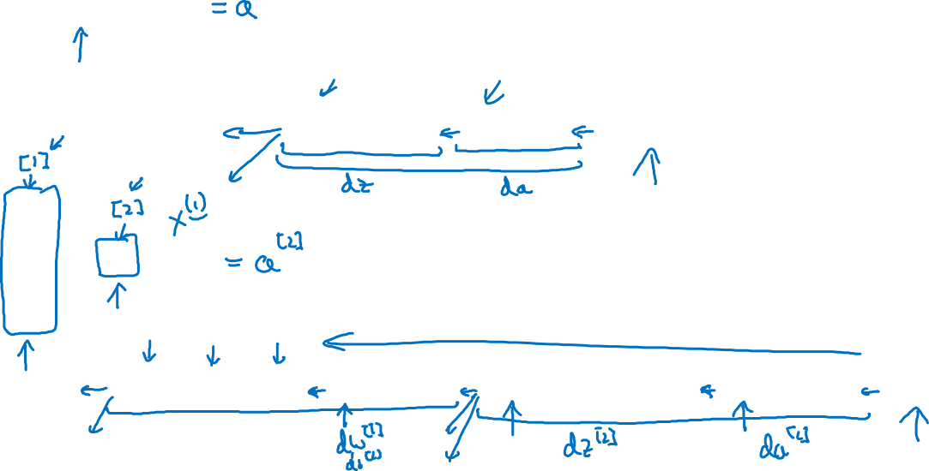





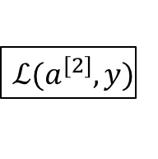







What is a Neural Network?
$$x_{1}$$
$$x_{2}$$
$$\hat{y}$$
$$x_{3}$$
x
w
$$z=w^{T}x+b$$
$$a=σ(z)$$
$$ℒ(a,y)$$
b
$$x_{1}$$
$$x_{2}$$
$$\hat{y}$$
$$x_{3}$$
x
$$W^{[1]}$$
$$z^{[1]}=W^{[1]}x+b^{[1]}$$
$$a^{[1]}=σ(z^{[1]})$$
$$z^{[2]}=W^{[2]}a_{ }^{[1]}+b^{[2]}$$
$$a^{[2]}=σ(z^{[2]})$$
$$ℒ(a^{[2]},y)$$
$$b^{[1]}$$
$$W^{[2]}$$
$$b^{[2]}$$

Slide 3
One hidden layer
Neural Network
Neural Network
Representation

Slide 4


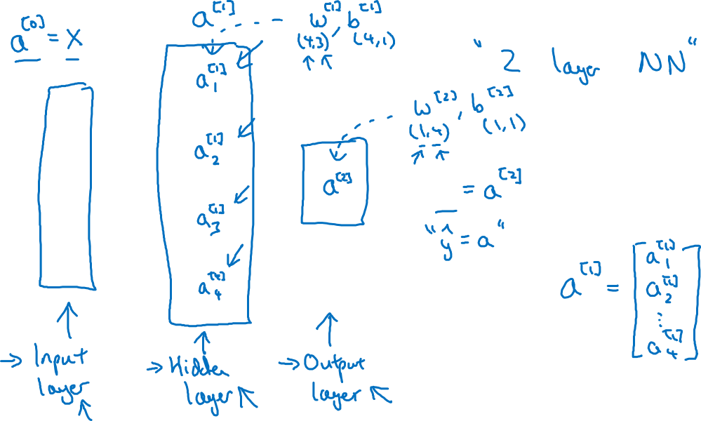


Neural Network Representation
$$x_{1}$$
$$x_{2}$$
$$\hat{y}$$
$$x_{3}$$

Slide 5
One hidden layer
Neural Network
Computing a
Neural Network’s
Output

Slide 6











Neural Network Representation
$$x_{1}$$
$$x_{1}$$
$$x_{2}$$
$$σ(z)$$
$$a=\hat{y}$$
$$x_{2}$$
$$\hat{y}$$
$$w^{T}x+b$$
$$z$$
$$a$$
$$x_{3}$$
$$x_{3}$$
$$z=w^{T}x+b$$
$$a=σ(z)$$

Slide 7

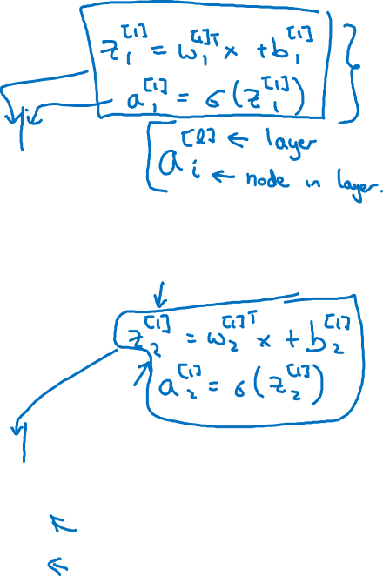





Neural Network Representation
$$x_{1}$$
$$x_{1}$$
$$x_{2}$$
$$σ(z)$$
$$a=\hat{y}$$
$$x_{2}$$
$$\hat{y}$$
$$w^{T}x+b$$
$$z$$
$$a$$
$$x_{3}$$
$$x_{3}$$
$$z=w^{T}x+b$$
$$x_{1}$$
$$a=σ(z)$$
$$x_{2}$$
$$\hat{y}$$
$$x_{3}$$

Slide 8

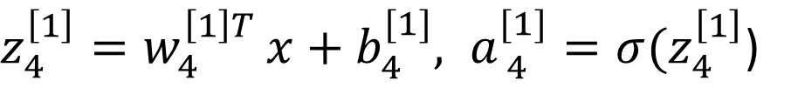


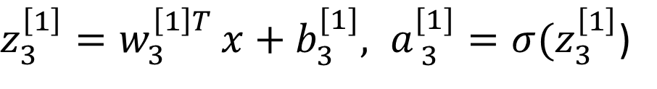


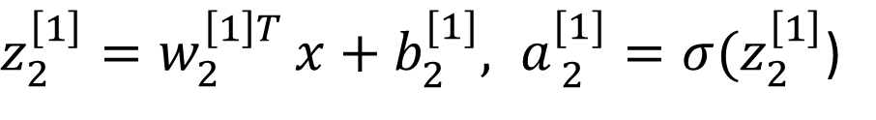

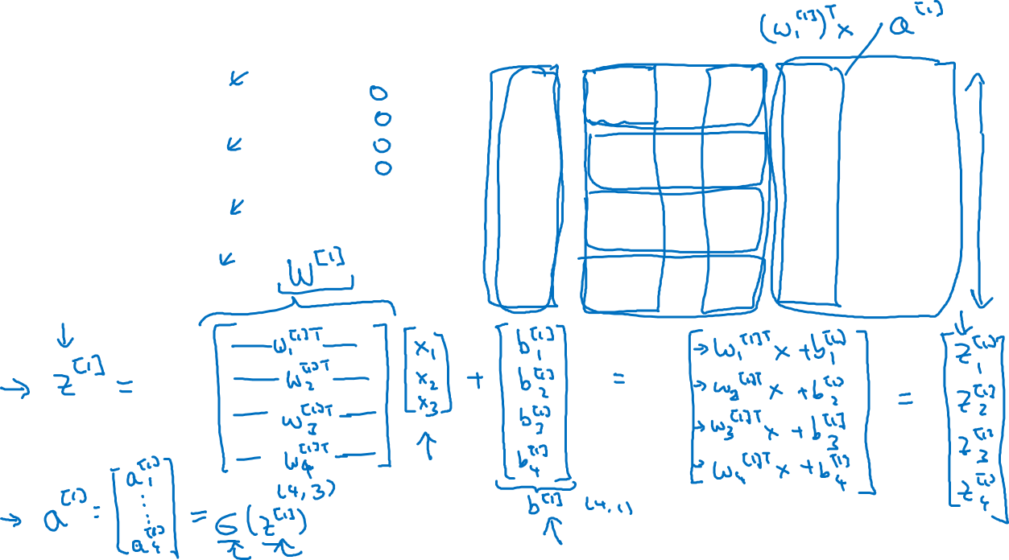
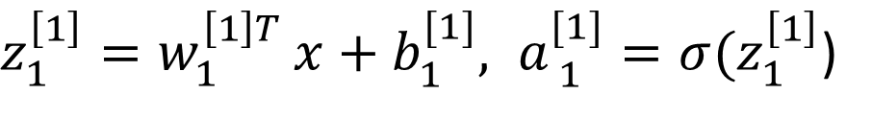


Neural Network Representation
$$a_{1}^{\left[1\right]}$$
$z_{1}^{\left[1\right]}=w_{1}^{{\left[1\right]T}^{ }}x+b_{1}^{[1]}, a_{ 1}^{[1]}=σ(z_{1}^{\left[1\right]}$)
$$x_{1}$$
$$a_{2}^{\left[1\right]}$$
$z_{2}^{\left[1\right]}=w_{2}^{{\left[1\right]T}^{ }}x+b_{2}^{[1]}, a_{ 2}^{[1]}=σ(z_{2}^{\left[1\right]}$)
$$x_{2}$$
$$\hat{y}$$
$$a_{3}^{\left[1\right]}$$
$z_{3}^{\left[1\right]}=w_{3}^{{\left[1\right]T}^{ }}x+b_{3}^{[1]}, a_{ 3}^{[1]}=σ(z_{3}^{\left[1\right]}$)
$$x_{3}$$
$$a_{4}^{\left[1\right]}$$
$z_{4}^{\left[1\right]}=w_{4}^{{\left[1\right]T}^{ }}x+b_{4}^{[1]}, a_{ 4}^{[1]}=σ(z_{4}^{\left[1\right]}$)

Slide 9



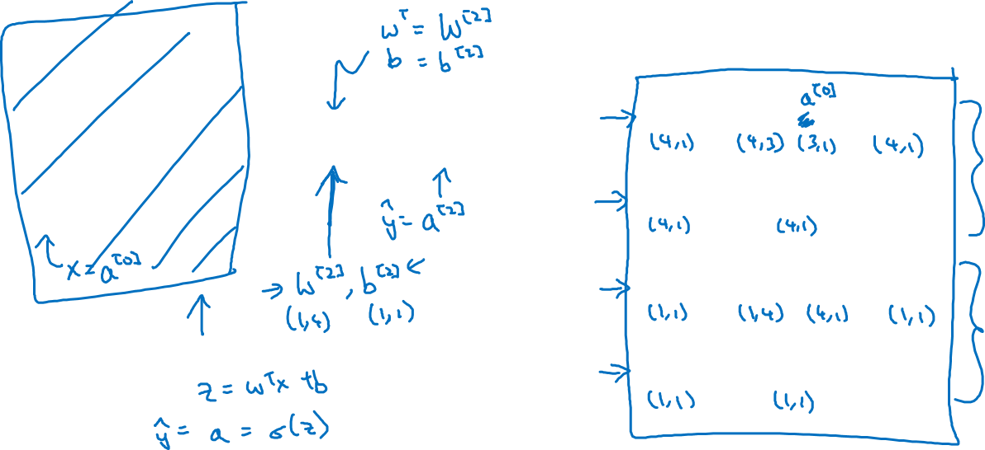

Neural Network Representation learning
$$a_{1}^{\left[1\right]}$$
Given input x:
$$x_{1}$$
$$a_{2}^{\left[1\right]}$$
$$z^{\left[1\right]}=W^{\left[1\right]}x+b^{\left[1\right]}$$
$$x_{2}$$
$$\hat{y}$$
$$a_{3}^{\left[1\right]}$$
$$x_{3}$$
$$a^{\left[1\right]}=σ(z^{\left[1\right]})$$
$$a_{4}^{\left[1\right]}$$
$$z^{\left[2\right]}=W^{\left[2\right]}a^{\left[1\right]}+b^{\left[2\right]}$$
$$a^{\left[2\right]}=σ(z^{\left[2\right]})$$

Slide 10
One hidden layer
Neural Network
Vectorizing across
multiple examples

Slide 11




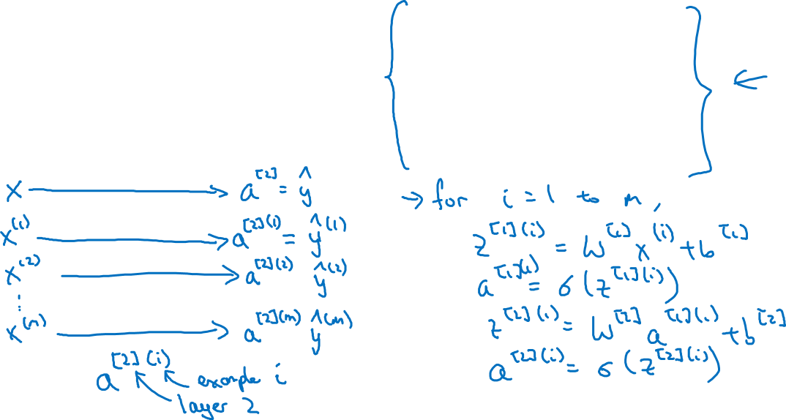

Vectorizing across multiple examples
$$z^{\left[1\right]}=W^{\left[1\right]}x+b^{\left[1\right]}$$
$$x_{1}$$
$$a^{\left[1\right]}=σ(z^{\left[1\right]})$$
$$x_{2}$$
$$\hat{y}$$
$$z^{\left[2\right]}=W^{\left[2\right]}a^{\left[1\right]}+b^{\left[2\right]}$$
$$x_{3}$$
$$a^{\left[2\right]}=σ(z^{\left[2\right]})$$

Slide 12
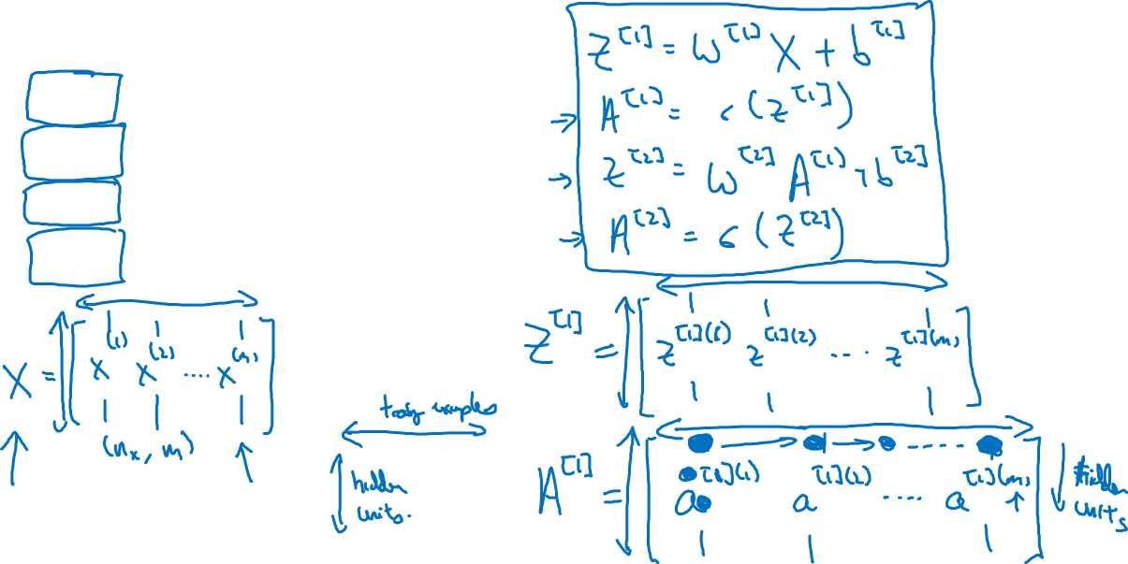




Vectorizing across multiple examples
for i = 1 to m:
$$z^{\left[1\right](i)}=W^{\left[1\right]}x^{(i)}+b^{\left[1\right]}$$
$$a^{\left[1\right](i)}=σ(z^{\left[1\right]\left(i\right)})$$
$$z^{\left[2\right](i)}=W^{\left[2\right]}a^{\left[1\right](i)}+b^{\left[2\right]}$$
$$a^{\left[2\right](i)}=σ(z^{\left[2\right]\left(i\right)})$$

Slide 13
One hidden layer
Neural Network
Explanation
for vectorized
implementation

Slide 14
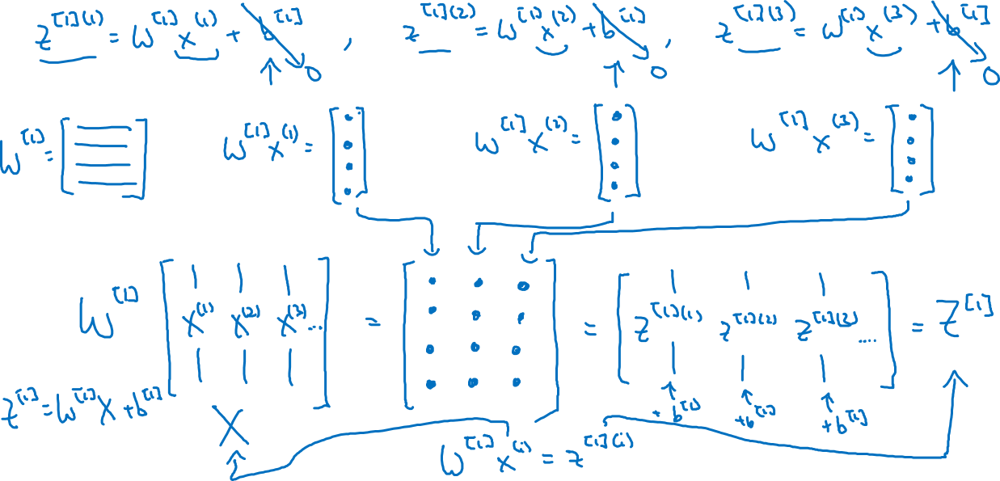
Justification for vectorized implementation

Slide 15











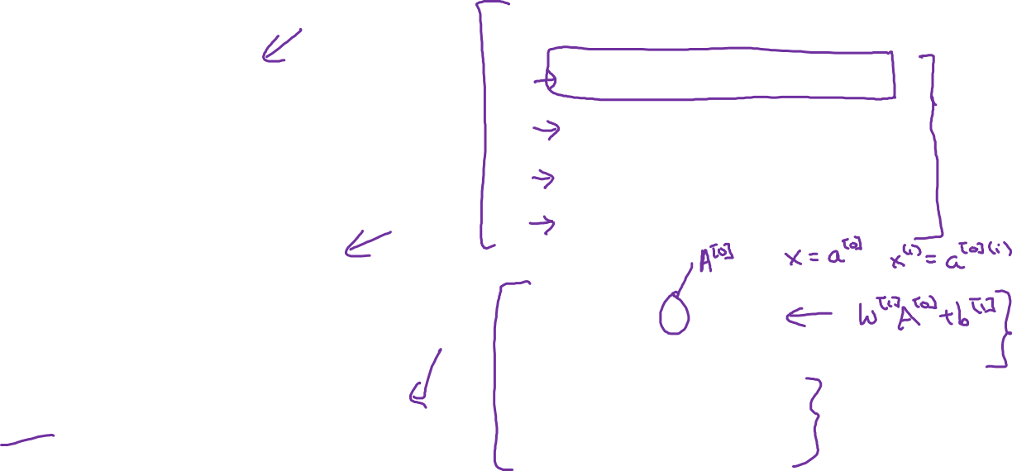





Recap of vectorizing across multiple examples
for i = 1 to m
$$x_{1}$$
$$z^{\left[1\right](i)}=W^{\left[1\right]}x^{(i)}+b^{\left[1\right]}$$
$$x_{2}$$
$$\hat{y}$$
$$x_{3}$$
$$a^{\left[1\right](i)}=σ(z^{\left[1\right]\left(i\right)})$$
$$z^{\left[2\right](i)}=W^{\left[2\right]}a^{\left[1\right](i)}+b^{\left[2\right]}$$
$$a^{\left[2\right](i)}=σ(z^{\left[2\right]\left(i\right)})$$
$$X=$$
$$x^{(1)}$$
$$x^{(2)}$$
…
$$x^{(m)}$$
$$Z^{\left[1\right]}=W^{\left[1\right]}X+b^{\left[1\right]}$$
$$A^{\left[1\right]}=σ(Z^{\left[1\right]})$$
$$Z^{\left[2\right]}=W^{\left[2\right]}A^{\left[1\right]}+b^{\left[2\right]}$$
$A^{[1]}=$
$$a^{[1](1)}$$
$$a^{[1](2)}$$
$$a^{[1](m)}$$
…
$$A^{\left[2\right]}=σ(Z^{\left[2\right]})$$

Slide 16
One hidden layer
Neural Network
Activation functions

Slide 17




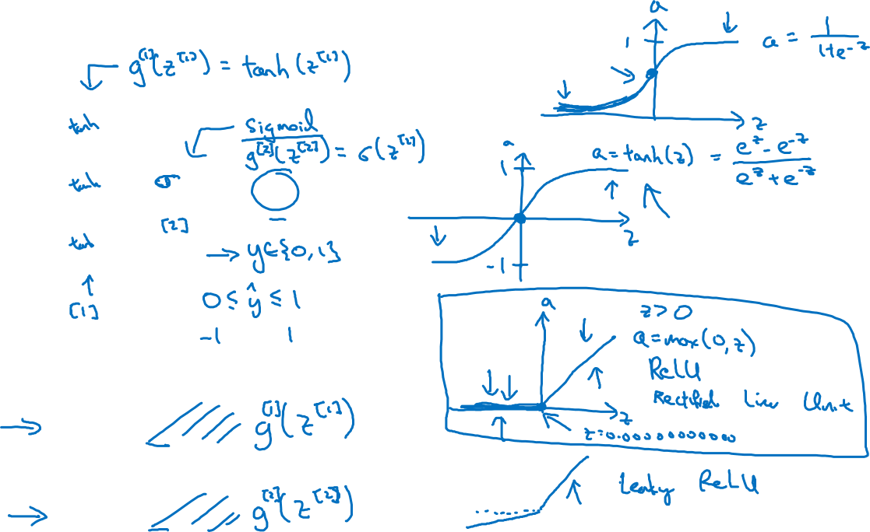


Activation functions
$$x_{1}$$
$$x_{2}$$
$$\hat{y}$$
$$x_{3}$$
Given x:
$$z^{\left[1\right]}=W^{\left[1\right]}x+b^{\left[1\right]}$$
$$a^{\left[1\right]}=σ(z^{\left[1\right]})$$
$$z^{\left[2\right]}=W^{\left[2\right]}a^{\left[1\right]}+b^{\left[2\right]}$$
$$a^{\left[2\right]}=σ(z^{\left[2\right]})$$

Slide 18
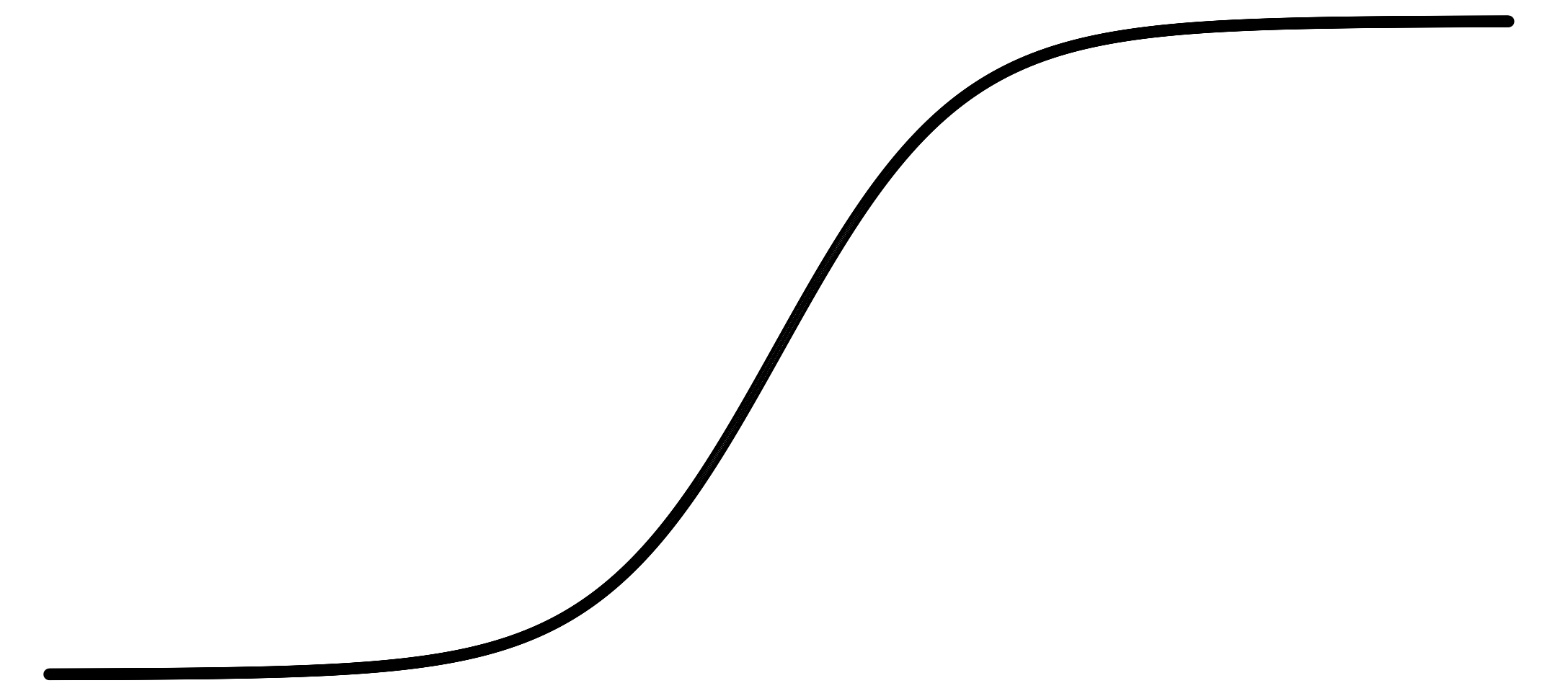
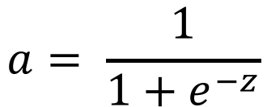
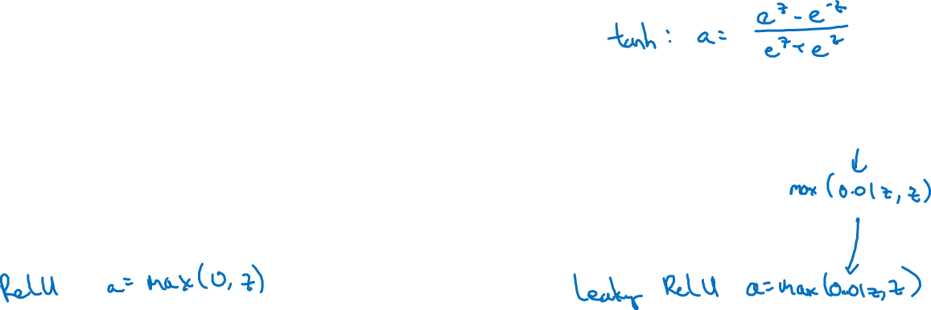
Pros and cons of activation functions
a
a
x
z
$$a= \frac{1}{1+e^{−z}}$$
sigmoid:
a
a
z
z

Slide 19
One hidden layer
Neural Network
Why do you
need non-linear
activation functions?

Slide 20



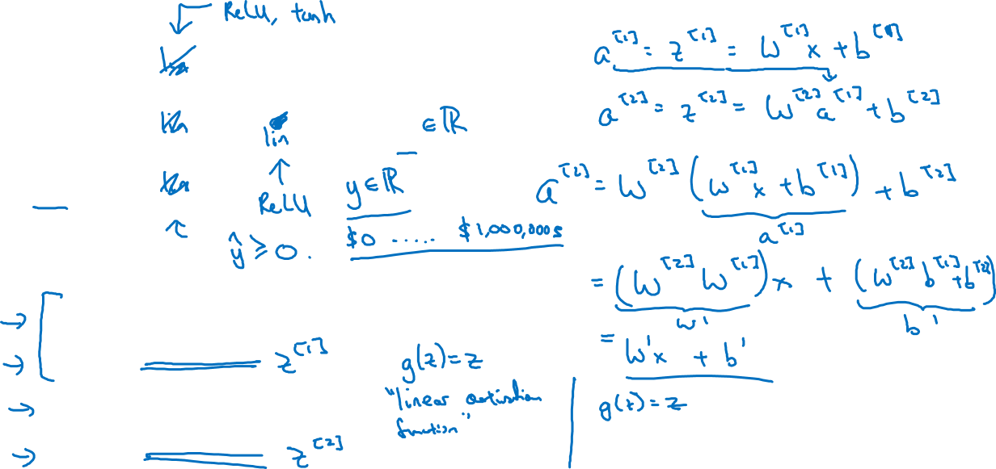



Activation function
$$x_{1}$$
$$x_{2}$$
$$\hat{y}$$
$$x_{3}$$
Given x:
$$z^{\left[1\right]}=W^{\left[1\right]}x+b^{\left[1\right]}$$
$$a^{\left[1\right]}=g^{[1]}(z^{\left[1\right]})$$
$$z^{\left[2\right]}=W^{\left[2\right]}a^{\left[1\right]}+b^{\left[2\right]}$$
$$a^{\left[2\right]}=g^{[2]}(z^{\left[2\right]})$$

Slide 21
One hidden layer
Neural Network
Gradient descent for
neural networks

Slide 22
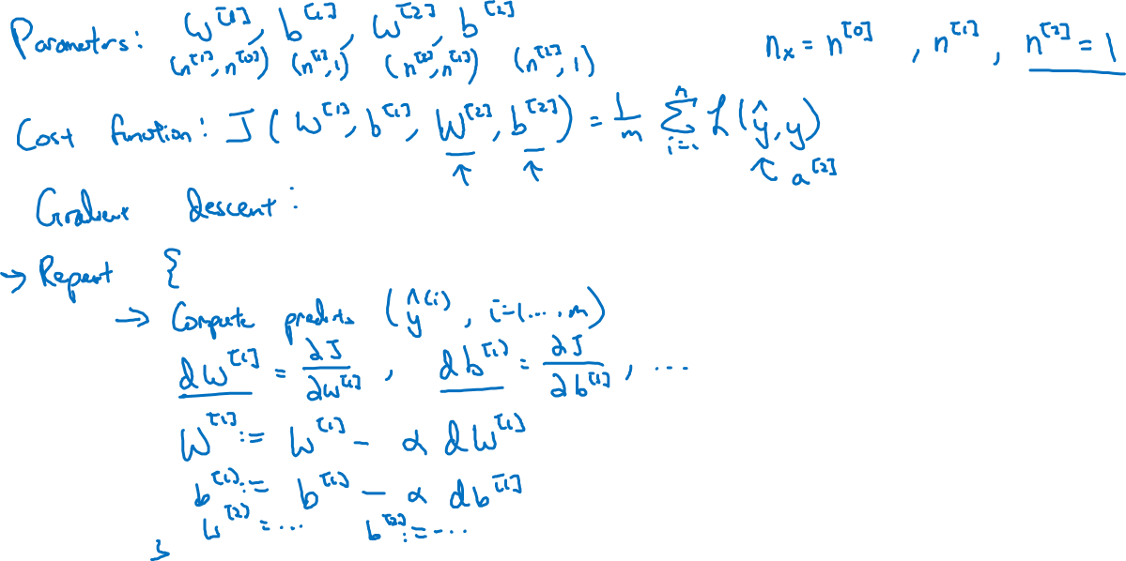
Gradient descent for neural networks

Slide 23
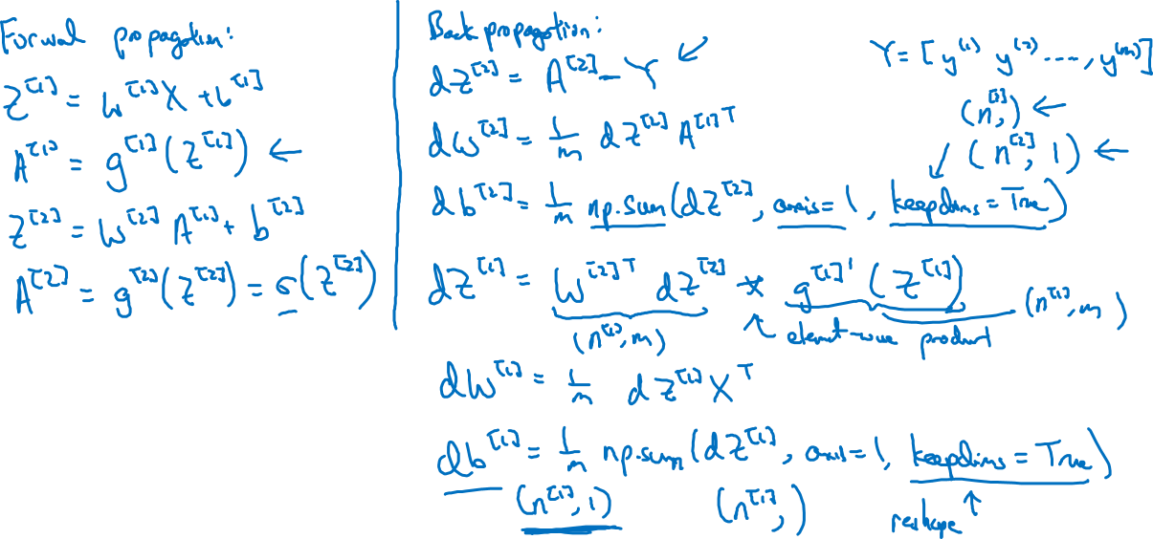
Formulas for computing derivatives

Slide 24
One hidden layer
Neural Network
Backpropagation
intuition (Optional)

Slide 25


$$x_{1}$$
for i = 1 to m
$$\hat{y}$$
$$x_{2}$$
$$z^{\left[1\right](i)}=W^{\left[1\right]}x^{(i)}+b^{\left[1\right]}$$
$$a^{\left[1\right](i)}=σ(z^{\left[1\right]\left(i\right)})$$
$$z^{\left[2\right](i)}=W^{\left[2\right]}a^{\left[1\right](i)}+b^{\left[2\right]}$$
$$a^{\left[2\right](i)}=σ(z^{\left[2\right]\left(i\right)})$$
$$X=$$
$$x^{(1)}$$
$$x^{(2)}$$
…
$$x^{(m)}$$
$$Z^{\left[1\right]}=W^{\left[1\right]}X+b^{\left[1\right]}$$
$$A^{\left[1\right]}=σ(Z^{\left[1\right]})$$
$$Z^{\left[2\right]}=W^{\left[2\right]}A^{\left[1\right]}+b^{\left[2\right]}$$
$A^{[1]}=$
$$a^{[1](1)}$$
$$a^{[1](2)}$$
$$a^{[1](m)}$$
…
$$A^{\left[2\right]}=σ(Z^{\left[2\right]})$$

Slide 26
Computing gradients
Logistic regression
$$x$$
$$w$$
$$z=w^{T}x+b$$
$$a= σ(z)$$
$$ℒ(a,y)$$
$$b$$

Slide 27
Neural network gradients
$$W^{[2]}$$
$$x$$
$$b^{[2]}$$
$$W^{[1]}$$
$$z^{[1]}=W^{[1]}x+b^{[1]}$$
$$a^{[1]}= σ(z^{[1]})$$
$$z^{[2]}=W^{[2]}x+b^{[2]}$$
$$a^{[2]}= σ(z^{[2]})$$
$$ℒ(a^{[2]},y)$$
$$b^{[1]}$$

Slide 28
Summary of gradient descent
$$dz^{[2]}=a^{[2]}−y$$
$$dW^{[2]}=dz^{[2]}a^{{\left[1\right]}^{T}}$$
$$db^{[2]}=dz^{[2]}$$
$$dz^{[1]}=W^{\left[2\right]T}dz^{[2]}∗g^{[1]}′(z^{\left[1\right]})$$
$$dW^{[1]}=dz^{[1]}x^{T}$$
$$db^{[1]}=dz^{[1]}$$

Slide 29
Summary of gradient descent
$$dz^{[2]}=a^{[2]}−y$$
$$dZ^{[2]}=A^{[2]}−Y$$
$$dW^{[2]}=dz^{[2]}a^{{\left[1\right]}^{T}}$$
$$dW^{[2]}=\frac{1}{m}dZ^{[2]}A^{{\left[1\right]}^{T}}$$
$$db^{[2]}=dz^{[2]}$$
$$db^{[2]}=\frac{1}{m}np.sum(dZ^{\left[2\right]},axis=1, keepdims=True)$$
$$dz^{[1]}=W^{\left[2\right]T}dz^{[2]}∗g^{[1]}′(z^{\left[1\right]})$$
$$dZ^{[1]}=W^{\left[2\right]T}dZ^{[2]}∗g^{[1]}′(Z^{\left[1\right]})$$
$$dW^{[1]}=dz^{[1]}x^{T}$$
$$dW^{[1]}=\frac{1}{m}dZ^{[1]}X^{T}$$
$$db^{[1]}=dz^{[1]}$$
$$db^{[1]}=\frac{1}{m}np.sum(dZ^{\left[1\right]},axis=1, keepdims=True)$$

Slide 30





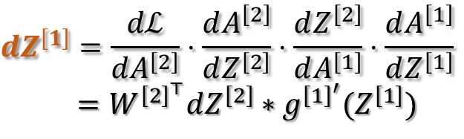





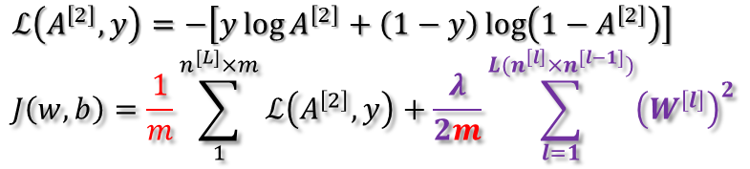


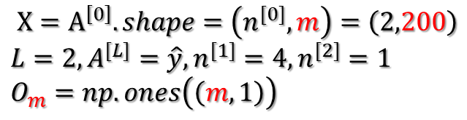
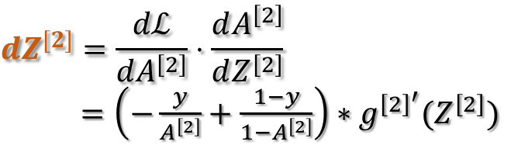




$$x_{1}$$
$X=A^{\left[0\right]}.shape=\left(n^{[0]},m\right)=\left(2,200\right)$
$$L=2,A^{[L]}=\hat{y},n^{[1]}=4,n^{[2]}=1$$
$$O_{m}=np.ones\left(\left(m,1\right)\right)$$
$$ℒ\left(A^{\left[2\right]},y\right)=−\left[y\log{A^{\left[2\right]}+\left(1−y\right)\log\left(1−A^{\left[2\right]}\right)}\right]$$
$$J\left(w, b\right)=\frac{1}{m}\sum_{1}^{n^{[L]}×m}{ℒ\left(A^{\left[2\right]},y\right)}+\frac{λ}{2m}\sum_{l=1}^{L(n^{\left[l\right]}×n^{[l−1]})}{{\left(W^{\left[l\right]}\right)}^{2}}$$
$$\hat{y}$$
$$x_{2}$$
$$W^{[1]}=W^{[1]}−α\left[dW^{\left[1\right]}+\frac{λ}{m}W^{\left[1\right]}\right]$$
$$W^{[2]}=W^{[2]}−α \left[dW^{\left[2\right]}+\frac{λ}{m}W^{\left[2\right]}\right]$$
$b^{[1]}$ =${ b}^{[1]} − α db^{\left[1\right]}$
$b^{[2]}$=${ b}^{[2]} − α db^{\left[2\right]}$
$$A^{\left[0\right]}$$
$$Z^{[1]}=W^{[1]}A^{\left[0\right]}+b^{[1]}$$
$$A^{[1]}=g^{\left[1\right]}(Z^{[1]})$$
$$Z^{[2]}=W^{[2]}A^{\left[1\right]}+b^{[2]}$$
$$A^{[2]}=g^{\left[2\right]}(Z^{[2]})$$
$$ℒ(A^{[2]},y)$$
$${(n}_{ }^{[1]},m)=\left(n_{ }^{[1]},n_{ }^{[0]}\right)\left(n_{ }^{[0]},m\right)+\left(n_{ }^{[1]},1\right) \left(n_{ }^{[1]},m\right) \left(n_{ }^{[2]},m\right)=\left(n_{ }^{[2]},n_{ }^{[1]}\right)\left(n_{ }^{[1]},m\right)+\left(n_{ }^{[2]},1\right) \left(n_{ }^{[2]},m\right) \left(1,1\right)$$
$${ \left(4,200\right)=\left(4,2\right) \left(2,200\right)+\left(4,1\right) \left(4,200\right) \left(1,200\right)=\left(1,4\right) \left(4,200\right)+\left(1,1\right) \left(1,200\right) (1,1)}_{ }$$
${db}^{[1]}={np.sum(dZ}^{\left[1\right]},axis=1,keepdims=true)$ / m
${db}^{[2]}={dZ}^{\left[2\right]}O_{m}$ / m
$${dW}^{[1]}={dZ}^{\left[1\right]}{A^{\left[0\right]}}^{⊤}$$
/ m
$${dW}^{[2]}={dZ}^{\left[2\right]}A^{{\left[1\right]}^{⊤}}$$
/ m
$$dZ^{\left[1\right]}=\frac{dℒ}{dA^{\left[2\right]}}⋅\frac{dA^{\left[2\right]}}{dZ^{\left[2\right]}}⋅\frac{dZ^{\left[2\right]}}{dA^{\left[1\right]}}⋅\frac{dA^{\left[1\right]}}{dZ^{\left[1\right]}}$$
$=W^{{\left[2\right]}^{⊤}}dZ^{\left[2\right]}∗{g^{{\left[1\right]}^{′}}(Z}^{\left[1\right]})$
$${dZ}^{[2]}=\frac{dℒ}{dA^{\left[2\right]}}⋅\frac{dA^{\left[2\right]}}{dZ^{\left[2\right]}}$$
$=\left(−\frac{y}{A^{\left[2\right]}}+\frac{1−y}{{1−A}^{\left[2\right]}}\right)∗{g^{{\left[2\right]}^{′}}(Z}^{\left[2\right]})$

Slide 31
One hidden layer
Neural Network
Random Initialization

Slide 32






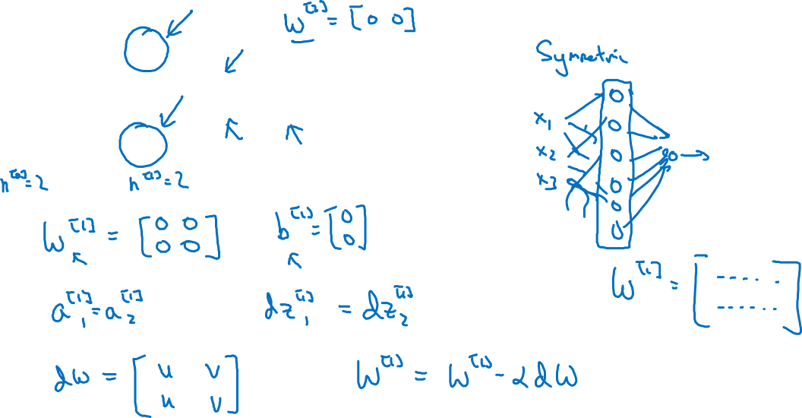
What happens if you initialize weights to zero?
$$x_{1}$$
$$a_{1}^{[1]}$$
$$a_{1}^{[2]}$$
$$\hat{y}$$
$$x_{2}$$
$$a_{2}^{[1]}$$

Slide 33
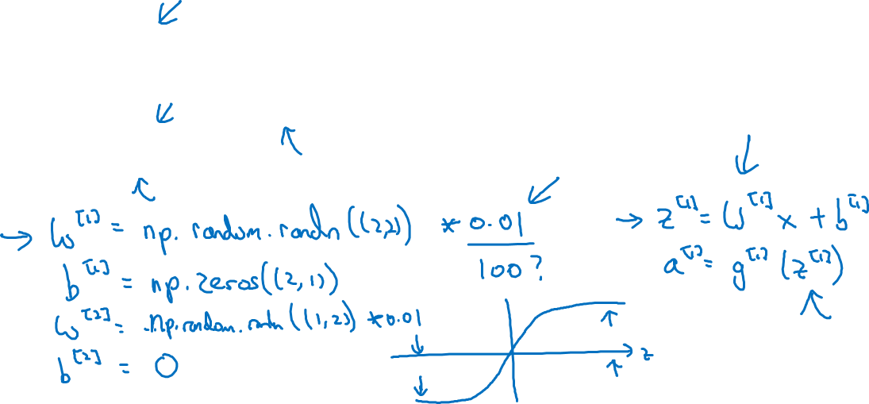
Random initialization
$$x_{1}$$
$$a_{1}^{[1]}$$
$$a_{1}^{[2]}$$
$$\hat{y}$$
$$x_{2}$$
$$a_{2}^{[1]}$$

